Slide 1
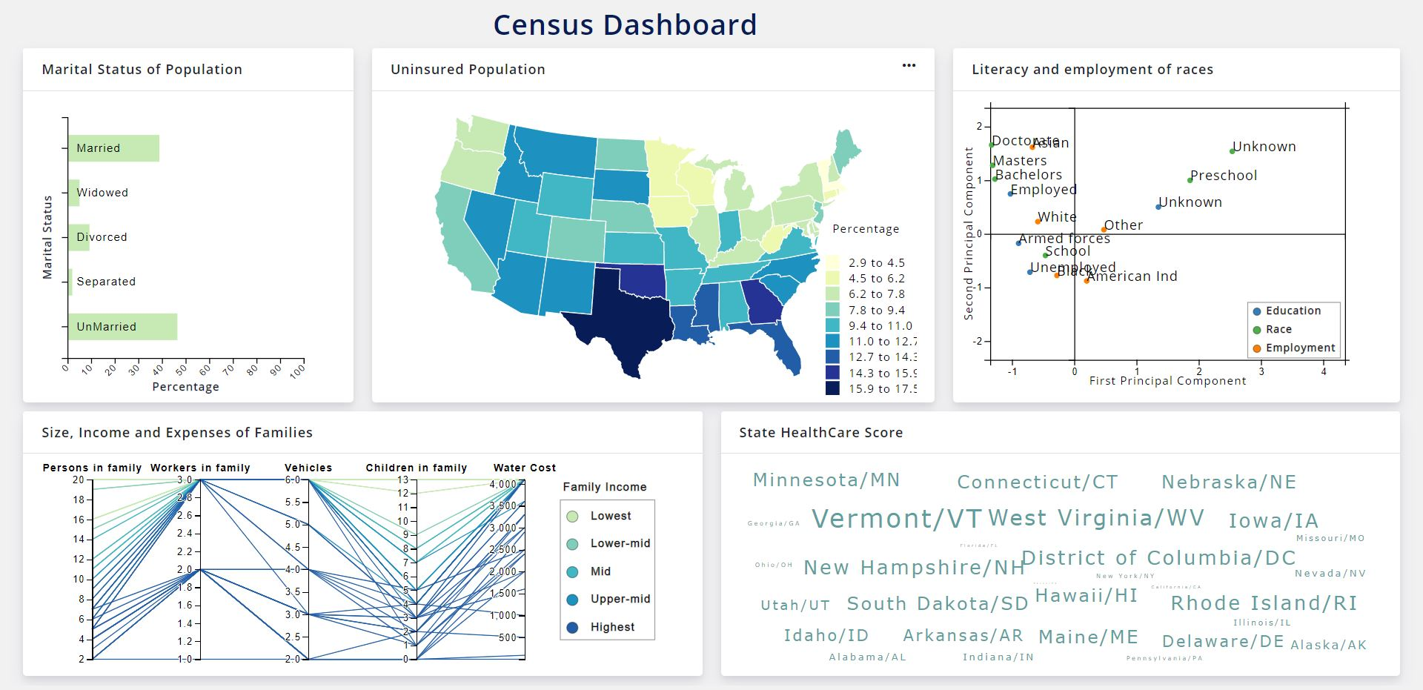
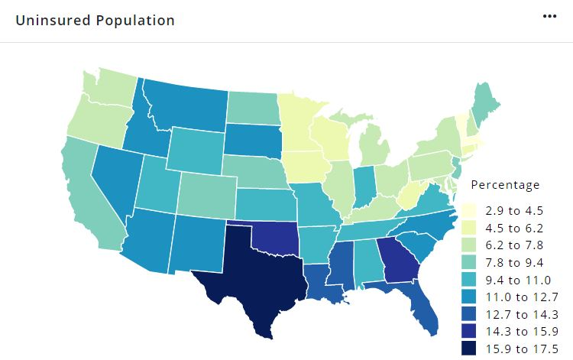
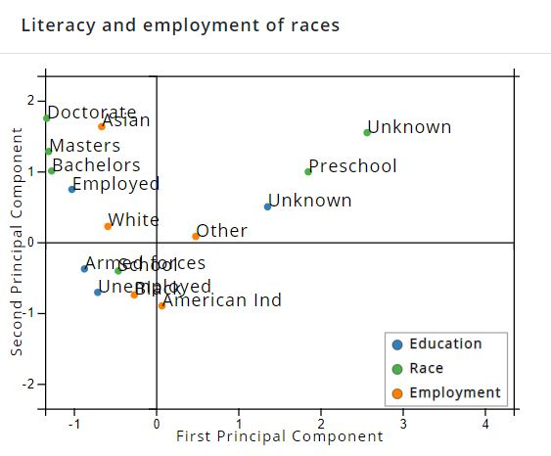
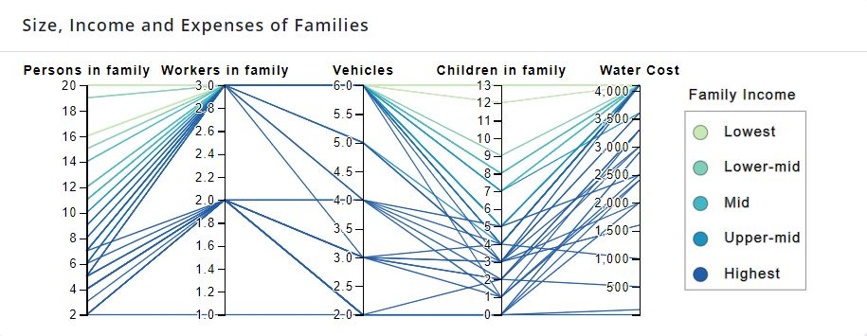
CSE 564: Final Project
Census Dashboard
Introduction
This dashboard provides a visual representation of interesting trends in the US Census data. It broadly explores three domains: Economy, Healthcare and Immigration.
It uses the 2015 US census dataset available on Kaggle of approximately 4GB in size.
We have used both standard ( bar chart, choropleth) and non standard (MCA, parallel co-ordinate map) visualizations to create an intuitive dashboard.
All elements must be visible at all times, and are inter-connected with brushing and linking, ie. changes to one visual element are reflected in the other elements as well.
Background
Visualizations
Insights
Census data plays a crucial role in providing deep insights into numerous domains, and helps policy makers in their decisions for a better future.
This kind of extensive information also unravels information that can have a huge impact on business and policy decisions.
In order to perform such tasks efficiently and without any hassle, such extensive information needs to be properly structured, cleaned and then visualized so that the end user can gain deep insights from the data within a very short amount of time.
The dashboard comprises of five visualizations. Details are as follows:
Choropleth Map: Provides a state level visualization of metrics such as unemployment, insurance and immigration.
Parallel co-ordinates plot: Shows correlation between dimensions and deep insights on families based on bracketing.
Word Cloud: Ranks states based on Economy, Healthcare, etc.
MCA: Visualizes relationship between categorical variables like Education, Race and Employment.
Bar Chart: Gives insights on marital status based on filters in other visualizations.
Number of Vehicles and number of children are positively correlated.
Asians are highly educated (Doctorate, Masters, Bachelors) and employed.
Populations with educational attainment till school are 99% unmarried as expected. However, the 1% comprising married, widowed or separated could be the ones who may have completed their 10th grade after their first marriage.
Unmarried population is more than married population.
Smaller states tend to have better healthcare, are less unemployed and have lesser immigrants compared to states bigger in size and vice versa.
Interior states, such as Nebraska, own many vehicles (upto 6) though they very less number of workers in family. This could due to lack of efficient public transport systems.
Figure 1. Choropleth Map
Figure 2. Multiple correspondence Analysis.
Figure 3. Parallel coordinates plot
Figure 3. Label in 28pt Calibri.
Team
Adnan Vasanwalla (112674911)
Pratik Mukund Velhal (112675099)
Notes:
big

